Slide 1
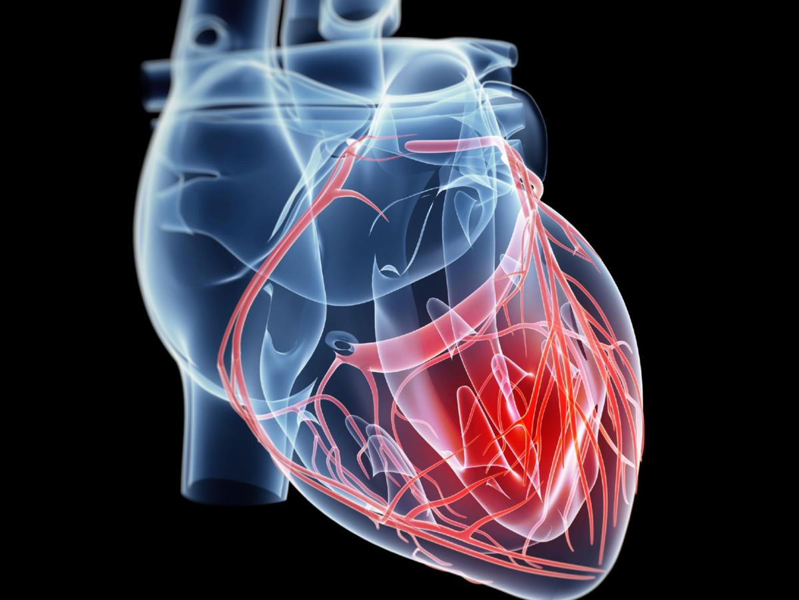
Disease ReportReport
Heart Disease
Heart disease poses a significant obstacle to global health, with its effects seen in communities and healthcare systems all across the world.
It is becoming more and more clear how important it is to prioritize cardiovascular health as we work through the COVID-19 pandemic’s complexity. The pandemic has brought to light the close relationship between general health and susceptibility to infectious illness, leading to a shared understanding of the critical need of preventive healthcare measures.

Slide 2
Disease ReportReport
Heart Disease
In order to get important insights on the frequency, distribution and demographics of the heart disease, we have ventured into a heart disease diagnostic database in this report.
In the face of the uncertainty surrounding pandemics and other health emergencies, we strive to extract actionable knowledge via the lens of data analysis and visualization tools.

Slide 3
Disease ReportReport
Heart Disease
Details of Data:
Age: The age of an individual.
2. Sex: Female represents 0 and male represents 1
3.Cholestrol: Serum cholesterol level in mg/dL.
4. Resting blood pressure: Resting blood pressure in mm Hg when the patient was admitted.
5. Chest Pain: Type of chest pain experienced. Often categorized into:
0: Typical angina
1: Atypical angina
2: Non-anginal pain
3: Asymptomatic
6. Exercise induced angina
7. The slope of the peak exercise ST segment: The slope of the peak exercise ST segment. Categories include:
0: Upsloping
1: Flat
2: Downsloping
8. Fasting blood sugar: Fasting blood sugar level > 120 mg/dL (1 = True, 0 = False).
9. Maximum heart rate achieved
10. Resting electrocardiographic results
11. Target

Slide 4
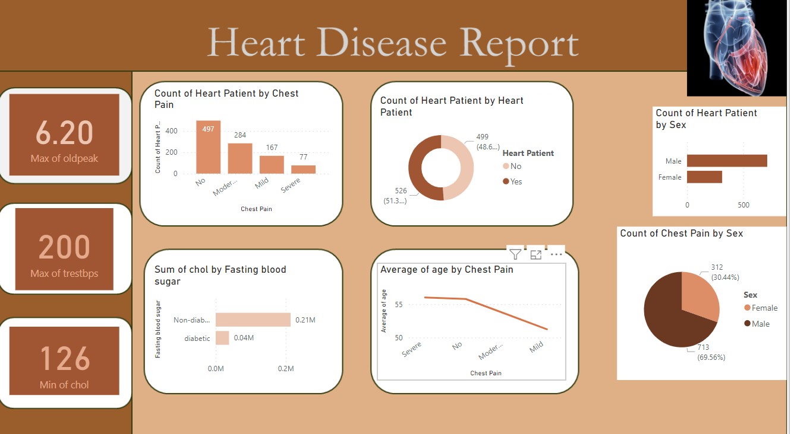
Heart Disease

Slide 5

Disease ReportReport
Heart Disease
Key Performance Indicators:
Chest pain(cp): Different types of chest pain can indicate the presence and severity of heart disease.
Exercise Induced Angina: Indicates if angina (chest pain) is induced by exercise, a key symptom of coronary artery disease.
Fasting Blood Sugar: High fasting blood sugar is a risk factor for diabetes, which is linked to heart disease.

Slide 6

Disease ReportReport
Heart Disease
The males are more prone to moderate or severe chest pain.
The maximum number of people have cholestrol above 200mg/dl and
less than 260mg/dl (approximately).
The highest number of people are non-diabetic.
The number of people who are heart patient are 300.

Slide 7
Disease ReportReport
Heart Disease
Thank You!

